Slide 1

Bidirectional Encoder RepresentAtions from Transformers (BERT)
Jian WANG, JINGYI WANG, XIAOFEI XUE

Slide 2
Agneda
What is BERT?
Applications
Coding Samples

Slide 3
What is BERT?
• BERT [1] is for pre-training Transformer’s [2] encoder.
• How? • Predict masked word. • Predict next sentence.
Reference
Devlin, Chang, Lee, and Toutanova. BERT: Pre-training of deep bidirectional transformers for language understanding. In ACL, 2019.
Vaswani and others. Attention is all you need. In NIPS, 2017.

Slide 4
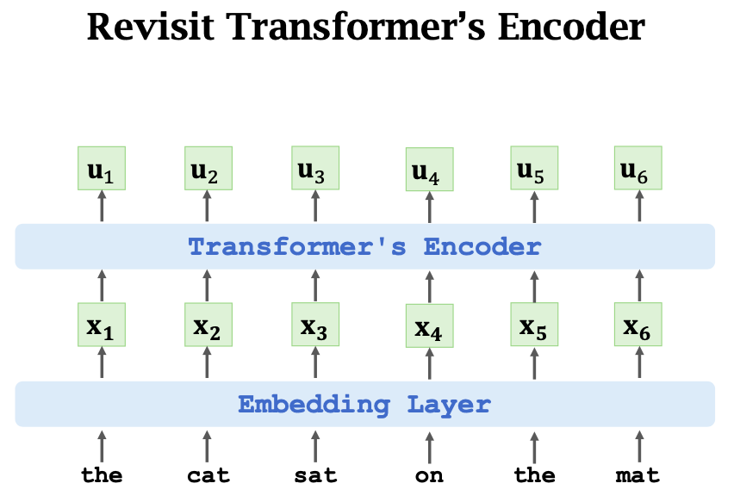

Slide 5
Task 1: Predict Masked Words

Slide 6
Randomly mask a word
• “The _____ sat on the mat”
• What is the masked word?

Slide 7
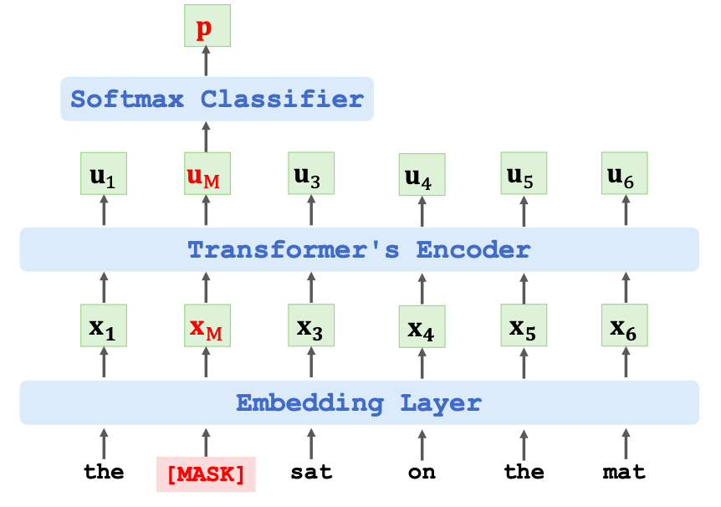

Slide 8
Predict the masked word
• 𝐞: one-hot vector of the masked word “cat”. • 𝐩: output probability distribution at the masked position. • Loss = CrossEntropy (𝐞, 𝐩) • Performing one gradient descent to update the model parameters.

Slide 9
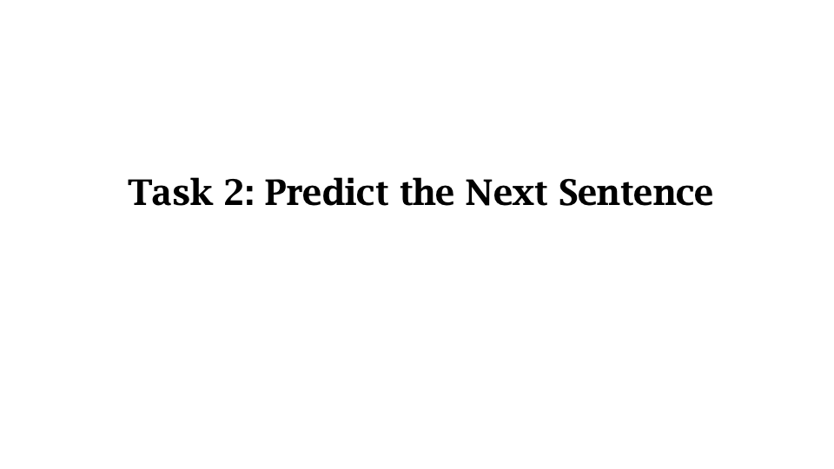

Slide 10
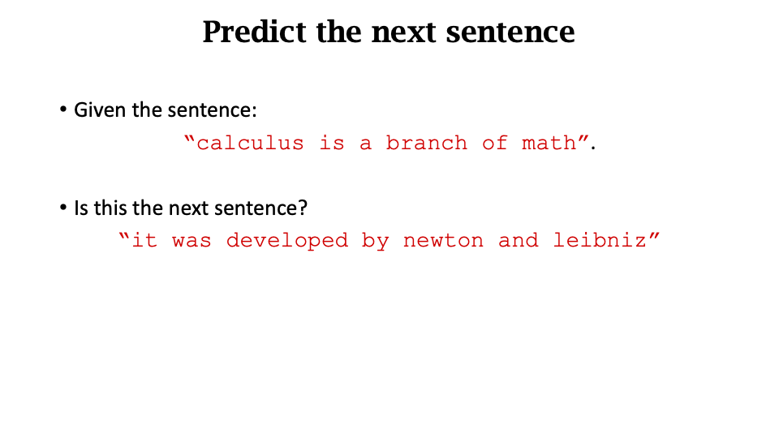

Slide 11
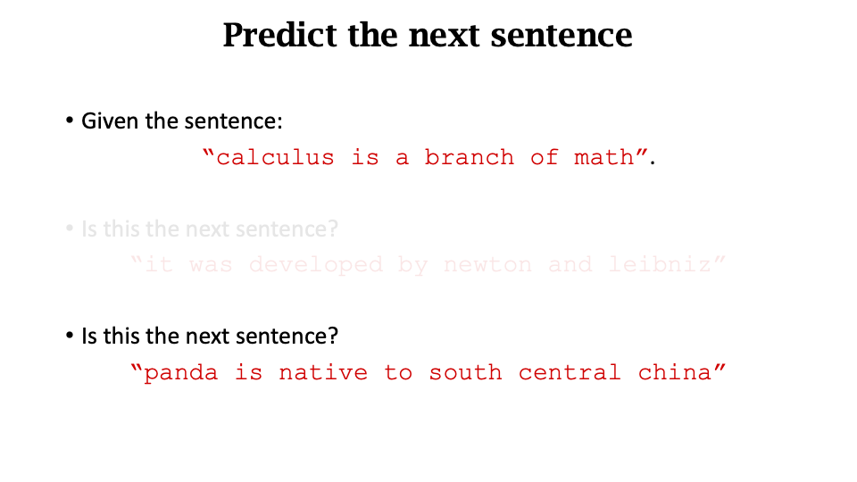

Slide 12
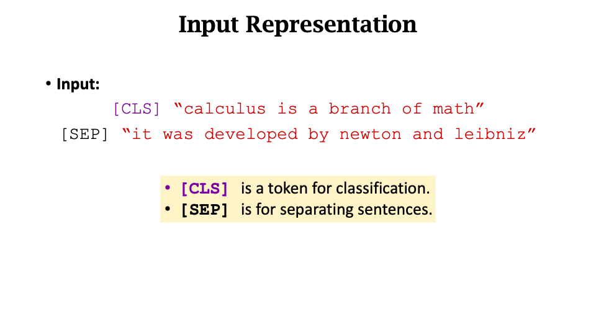

Slide 13
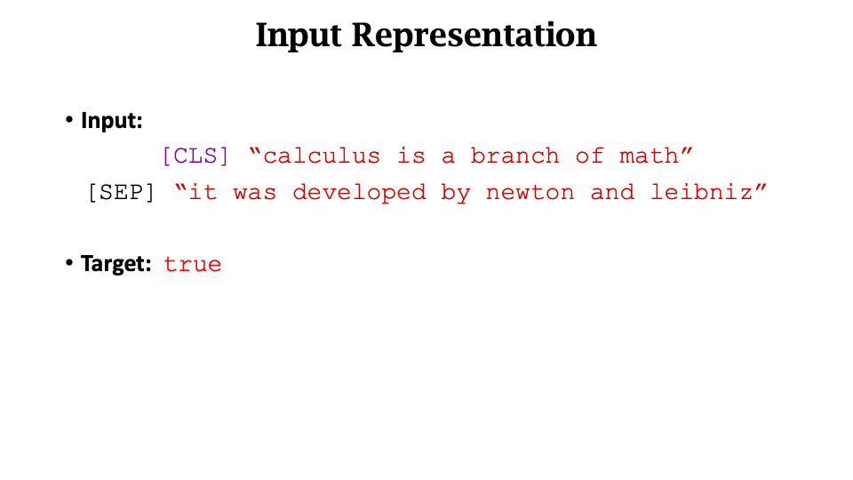

Slide 14
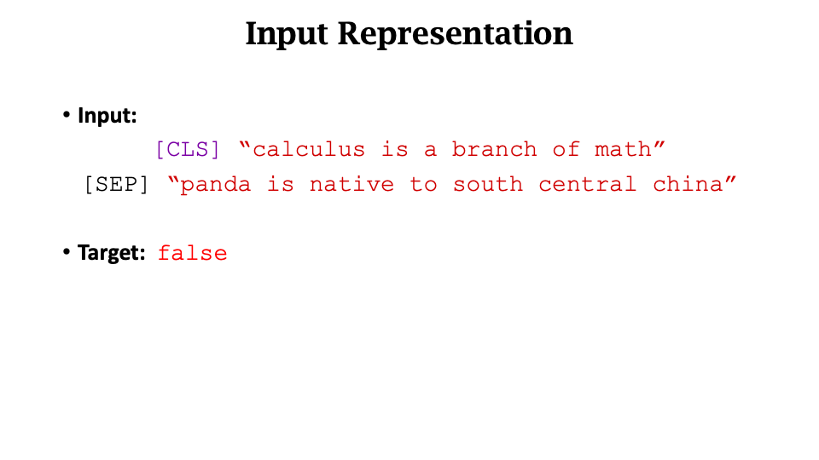

Slide 15
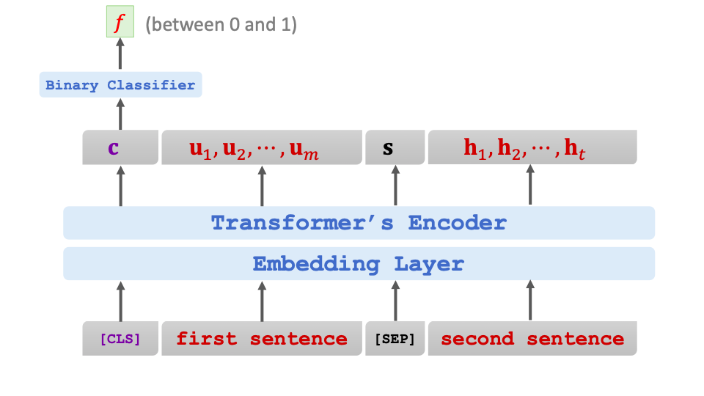

Slide 16
Combining the two methods

Slide 17
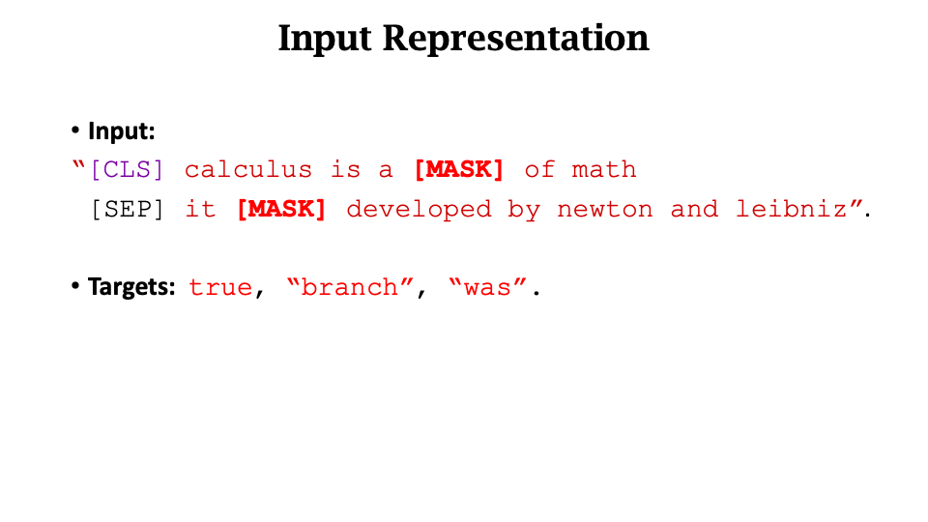

Slide 18
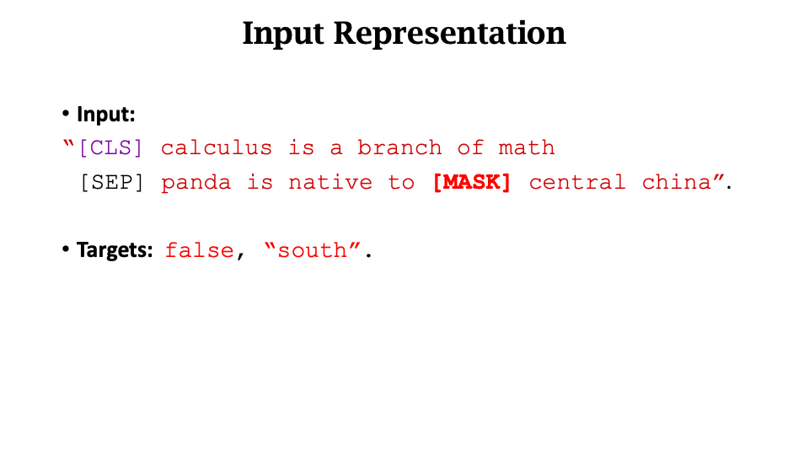

Slide 19
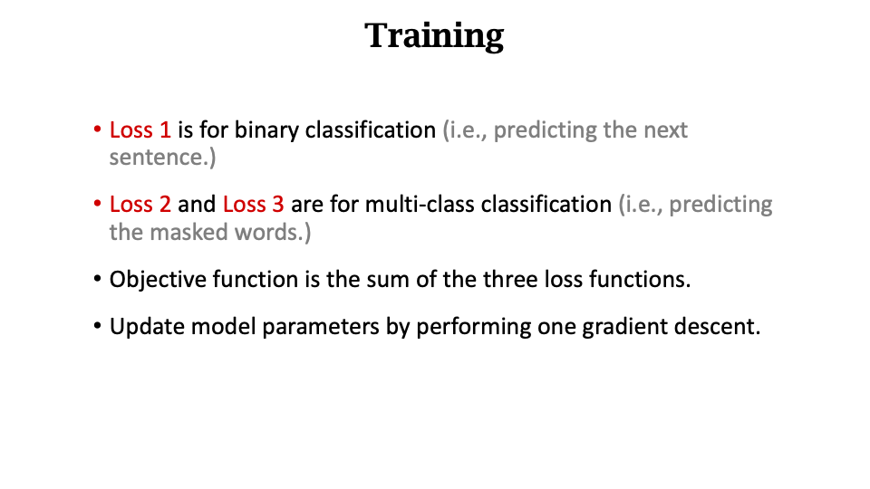

Slide 20
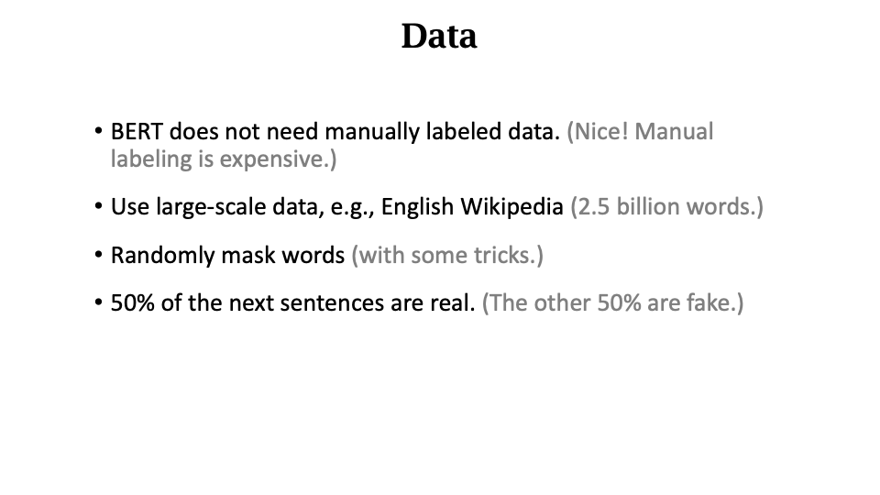

Slide 21
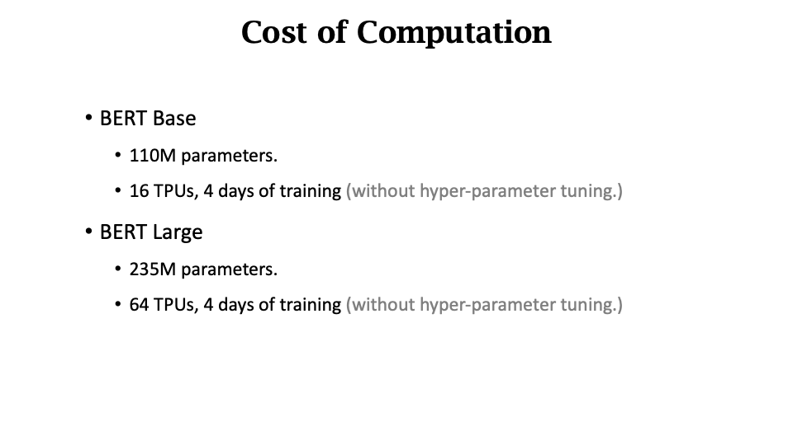

Slide 22
BERT
Full Name: Bidirectional Encoder Representations from Transformers
Published by Google AI Language
BERT’s key technical innovation is applying the bidirectional training of Transformer, a popular attention model, to language modelling.

Slide 23
How BERT works
BERT makes use of Transformer, an attention mechanism that learns contextual relations between words (or sub-words) in a text.
Transformer includes two separate mechanisms:
an encoder that reads the text input
a decoder that produces a prediction for the task

Slide 24
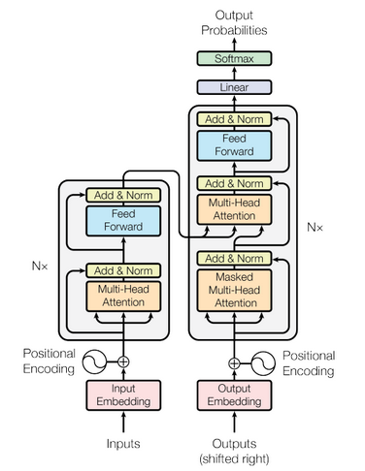
Transformer structure
The Encoder block has 1 layer of a Multi-Head Attention followed by another layer of Feed Forward Neural Network.
The Decoder has an extra Masked Multi-Head Attention.
The encoder and decoder blocks are multiple identical encoders and decoders stacked on top of each other.
Both the encoder stack and the decoder stack have the same number of units.

Slide 25
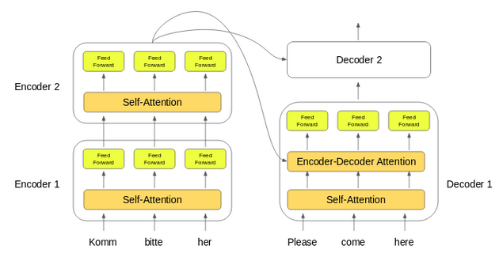
Encoder & Decoder
The word embeddings of the input sequence are passed to the first encoder
Then they are transformed and propagated to the next encoder
The output from the last encoder in the encoder-stack is passed to all the decoders in the decoder-stack.
In addition to the self-attention and feed-forward layers, the decoders also have one more layer of Encoder-Decoder Attention layer. This helps the decoder focus on the appropriate parts of the input sequence

Slide 26
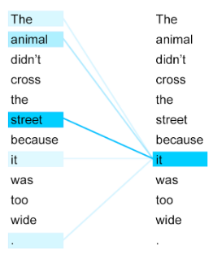
SELF-ATTENTION?
Self-attention, sometimes called intra-attention, is an attention mechanism relating different positions of a single sequence in order to compute a representation of the sequence.
Can you figure out what the term “it” in this sentence refers to?
Self-attention allows the model to look at the other words in the input sequence to get a better understanding of a certain word in the sequence.

Slide 27
Calculating Self-Attention
Step 1: create three vectors from each of the encoder’s input vectors:
Query Vector
Key Vector
Value Vector
Step 2: calculate self-attention for every word in the input sequence
Example "Action gets results"
To calculate the self-attention for the first word “Action”, we will calculate scores for all the words in the phrase with respect to “Action”.
This score determines the importance of other words when we are encoding a certain word in an input sequence

Slide 28
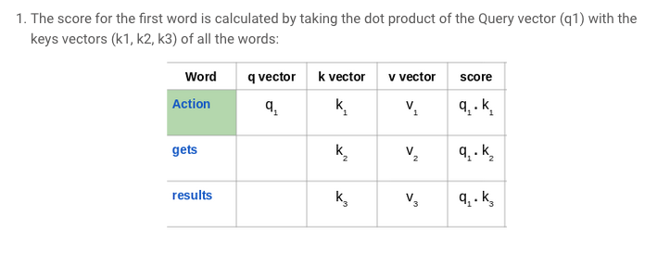
Calculate SELF-ATTENTION

Slide 29
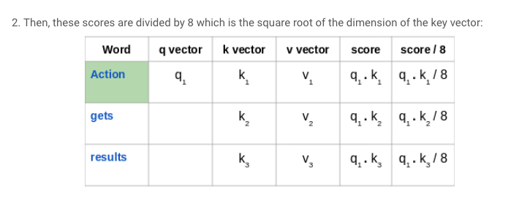
Calculate SELF-ATTENTION

Slide 30
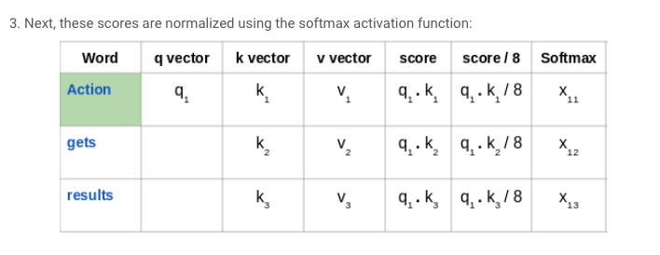
Calculate SELF-ATTENTION

Slide 31
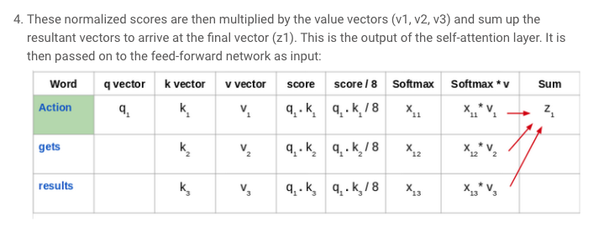
Calculate SELF-ATTENTION

Slide 32
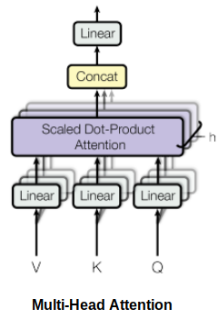
Calculate SELF-ATTENTION
Self-attention is computed not once but multiple times in the Transformer’s architecture, in parallel and independently. It is therefore referred to as Multi-head Attention.
The outputs are concatenated and linearly transformed.
Multi-head attention allows the model to jointly attend to information from different representation subspaces at different positions.

Slide 33
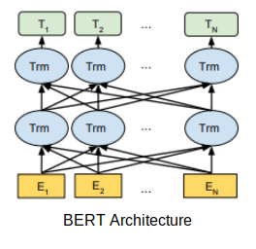
BERT’s Model Architecture
BERT uses a multi-layer bidirectional Transformer encoder. Its self-attention layer performs self-attention in both directions.
Google has released two variants of the model:
BERT Base: Number of Transformers layers = 12, Total Parameters = 110M
BERT Large: Number of Transformers layers = 24, Total Parameters = 340M

Slide 34
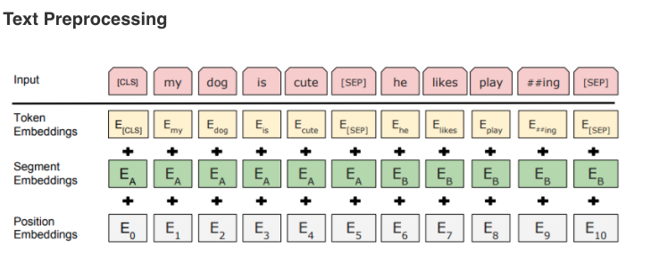
HOW TO USE BERT?
Position Embeddings: BERT learns and uses positional embeddings to express the position of words in a sentence. These are added to overcome the limitation of Transformer which, unlike an RNN, is not able to capture “sequence” or “order” information
Segment Embeddings: BERT can also take sentence pairs as inputs for tasks (Question-Answering). That’s why it learns a unique embedding for the first and the second sentences to help the model distinguish between them. In the above example, all the tokens marked as EA belong to sentence A (and similarly for EB)
Token Embeddings: These are the embeddings learned for the specific token from the WordPiece token vocabulary

Slide 35
Application: SCIBERT
Allen Institute for Artificial Intelligence (AI2) further study on BERT and released SciBERT which is based on BERT to address the performance on scientific data.
It uses a pre-trained model from BERT and fine-tune contextualized embeddings by using 1.14 M scientific publications randomly picked from Semantic Scholar, which including 18% papers from computer science domain and 82% from the broad biomedical domain to build SciBERT.

Slide 36
Application: biobert
Lee and other researchers work on biomedical domain. They noticed that generic pretrained NLP model may not work very well in specific domain data. Therefore, they fine-tuned BERT to be BioBERT and 0.51% ~ 9.61% absolute improvement in biomedical’s NER, relation extraction and question answering NLP tasks.
They used BERT’s original training data which includes English Wikipedia and BooksCorpus and domain specific data which are PubMed abstracts and PMC full text articles to fine-tuning BioBERT model.

Slide 37
REFERENCE
https://www.analyticsvidhya.com/blog/2019/09/demystifying-bert-groundbreaking-nlp-framework/
https://www.analyticsvidhya.com/blog/2019/06/understanding-transformers-nlp-state-of-the-art-models/?utm_source=blog&utm_medium=demystifying-bert-groundbreaking-nlp-framework
https://towardsdatascience.com/bert-explained-state-of-the-art-language-model-for-nlp-f8b21a9b6270
https://appliedmachinelearning.blog/2019/03/04/state-of-the-art-text-classification-using-bert-model-predict-the-happiness-hackerearth-challenge/
https://towardsdatascience.com/how-to-apply-bert-in-scientific-domain-2d9db0480bd9

Slide 38
How to use BERT
Bert as service
https://github.com/hanxiao/bert-as-service
Using BERT for Binary Text Classification, fine-tuning
https://medium.com/swlh/a-simple-guide-on-using-bert-for-text-classification-bbf041ac8d04
https://github.com/ThilinaRajapakse/BERT_binary_text_classification
DistilBERT
https://medium.com/huggingface/distilbert-8cf3380435b5
Colab https://colab.research.google.com/github/jalammar/jalammar.github.io/blob/master/notebooks/bert/A_Visual_Notebook_to_Using_BERT_for_the_First_Time.ipynb
Bert-text
https://towardsdatascience.com/how-to-do-text-binary-classification-with-bert-f1348a25d905
Import issue
https://github.com/wshuyi/demo-text-binary-classification-with-bert/blob/master/bert_text_classification.ipynb

Slide 39
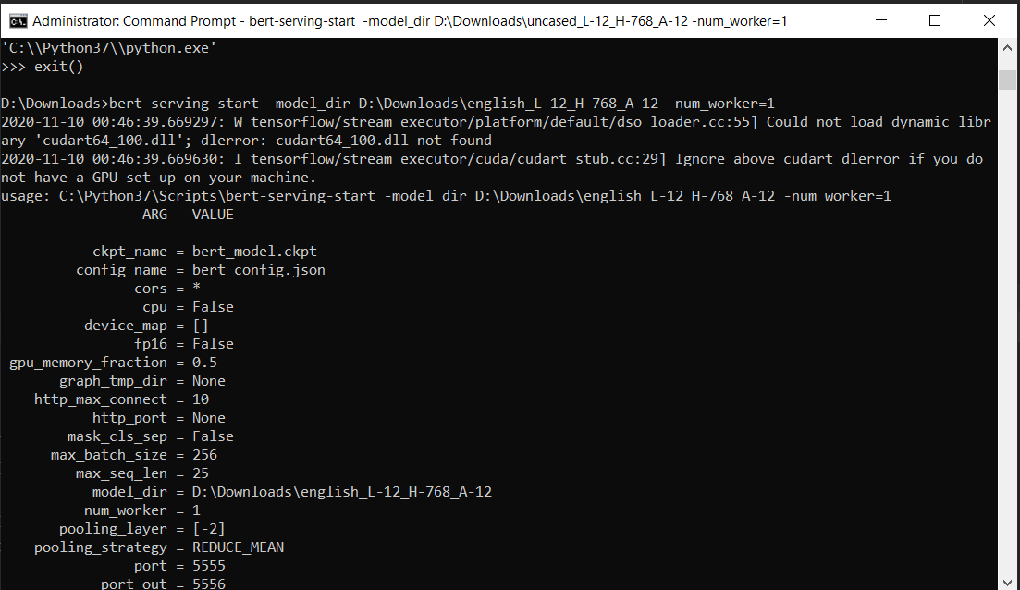
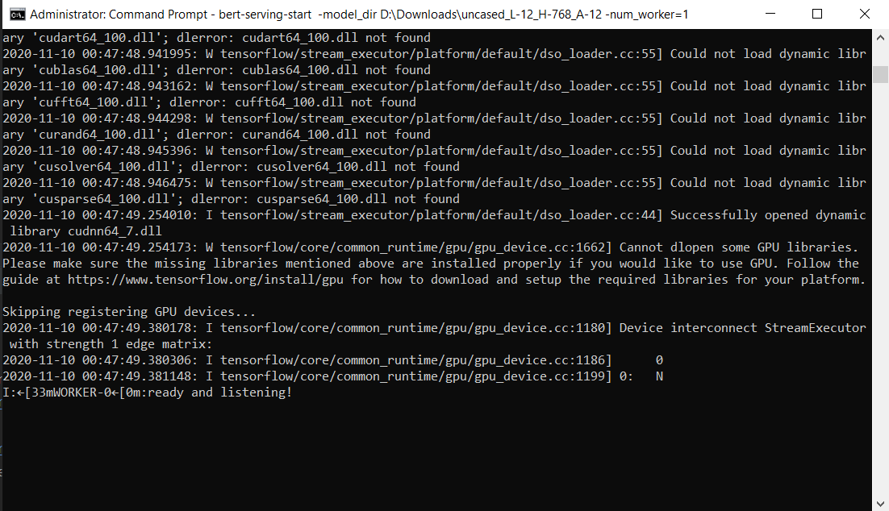
Bert as service
https://github.com/hanxiao/bert-as-service
Code
bert_service_example.py
Similarity_using_bert.py

